Slide 1
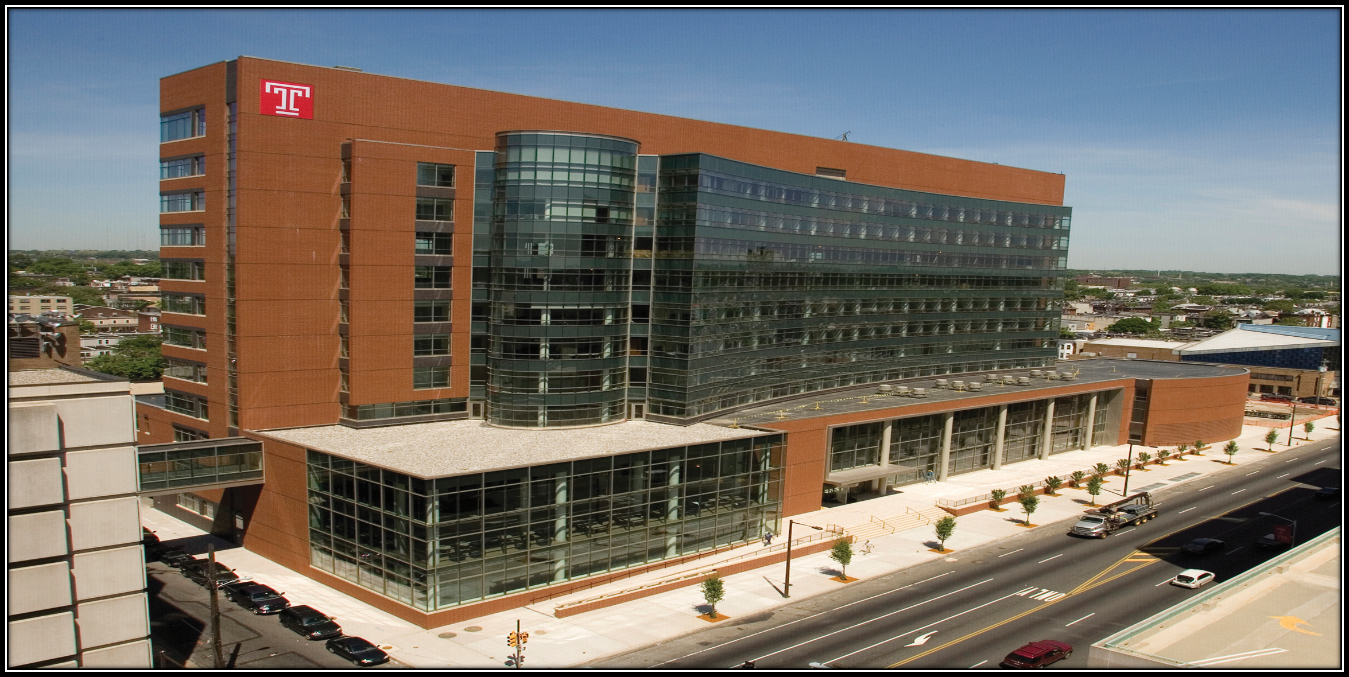
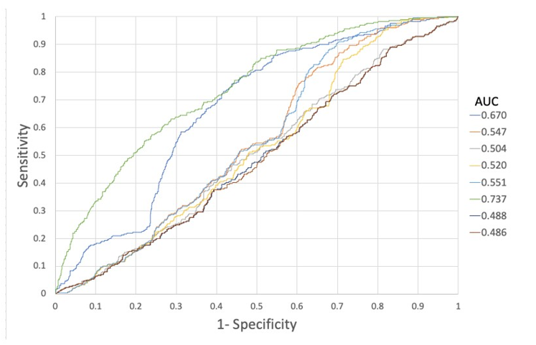
Developing a Screening Tool to Predict Diabetic Retinopathy
Philippe Ortiz BA, Thomas Dunn BS, Shyla McMurtry BS, Ely Manstein BS, Martin Porebski BS, Michael Stelmach BS, Xiaoning Lu MS, Daohai Yu PhD, Jeffrey Henderer MD, Yi Zhang MD, PhD
Purpose
Results
Results
Current AAO Practice Patterns recommend that all patients with diabetes undergo annual screening for diabetic retinopathy (DR).
Previous screenings at Temple university reveal only a 15% prevalence of DR.
Performing a comprehensive eye exam for patients without DR increases healthcare costs, reduces appointment availability and wastes time for patients and providers.
We present a DR screening tool based on biometric parameters (Table 1) available to any primary care physician to identify patients at low risk of DR who can safely have less frequent eye exams.
Biometric Parameter | Value (β) | Estimate
Intercept |  | -3.6374
Time with Diabetes | 5-10 | -0.0778
Time with Diabetes | >10 | 0.7300
HbA1c Group | 5.7-6.4 | -0.7459
HbA1c Group | 6.5-10 | 0.1810
HbA1c Group | >10 | 0.7753
Systolic Blood Pressure |  | 0.0122
Blood Urea Nitrogen |  | 0.0326
Med Type | Insulin | 0.6036
Med Type | Oral Meds | -0.3240
Med Type | Oral+insulin | 0.1918
Age Group | 50-60 | -0.0905
Age Group | >60 | -0.2712
Odds= Intercept + β₁*Estimate₁…+ β_{N}*Estimate_{N}
Equation 1: Calculation of odds from Maximum Likelihood Estimates in Table 1
Probability of DR = $\frac{e^{Odds}}{1+e^{Odds}}$
Methods
1937 patients with DM underwent DR screenings from 2016-2020.
A retrospective chart review recorded 29 biometric variables based on clinical suspicion of predicting DR
896 patients with unreadable fundus photos or missing variables were eliminated.
Univariate and multivariate analysis identified predictive variables in the remaining 1031 patients.
Logistic regression with maximum likelihood estimates were used to create a series of models that resulted in a score representing likelihood an individual patient has DR on exam.
Models were plotted on receiver operating characteristic (ROC) curves to determine model accuracy and to identify a threshold value that optimizes the accuracy of DR screening exam.
Equation 2: Calculation of Probability of DR from Equation 1
Conclusions
Table 1: Biometric Parameters and Analysis of Maximum Likelihood Estimates
Any diabetic patient with the biometric parameters in Table 1 available can be screened by calculating a “probability score” from both equations above.
A model created from these specific parameters has not been described previously.
Our best model demonstrated moderate sensitivity and high specificity to identify DR using a cutoff probability score of 0.375.
Any patient with a score lower than 0.375 is less likely to have DR and can safely defer exam.
A next step will be to use this model, created with readily available biometric data, to predict DR in a new patient cohort.
If successful, we hope this model can be employed in the primary care setting to better identify patients more likely to have DR and reduce the number of unnecessary eye exams.
Results
Of 1031 patients, 217 (21%) were found to have DR in at least one eye.
8 models were created using the biometric variables and plotted on ROC curves (Figure 1).
Area under the curve (AUC) of the leading model was 0.74.
Closest to (0,1) Criteria determined the optimal cutoff value of 0.375 with sensitivity and specificity of 48.8% and 82.1% respectively and accuracy of 0.76.
REFERENCES:
Flaxel CJ, Adelman RA, Bailey ST, Fawzi A, Lim JI, Vemulakonda GA, Ying GS. Diabetic Retinopathy Preferred Practice Pattern®. Ophthalmology. 2020 Jan;127(1):P85-P90.
2. Lund SH, Aspelund T, Kirby P, Russell G, Einarsson S, Palsson O, Stefánsson E. Individualised risk assessment for diabetic retinopathy and optimisation of screening intervals: a scientific approach to reducing healthcare costs. Br J Ophthalmol. 2016 May;100(5):683-7.
Benjamin JE, Sun J, Cohen D, Matz J, Barbera A, Henderer J, Cheng L, Grachevskaya J, Shah R, Zhang Y. A 15 month experience with a primary care-based telemedicine screening program for diabetic retinopathy. BMC Ophthalmol. 2021 Feb 4;21(1):70.
There was no funding for this project.
Figure 1: ROC Curves for Models Predictive of DR with arrow showing leading model

